Slide 1



Mexico Sales dashboard
View in Power BI
Last data refresh:
08/02/2023 10:54:57 UTC
Downloaded at:
08/02/2023 11:01:38 UTC

Slide 2
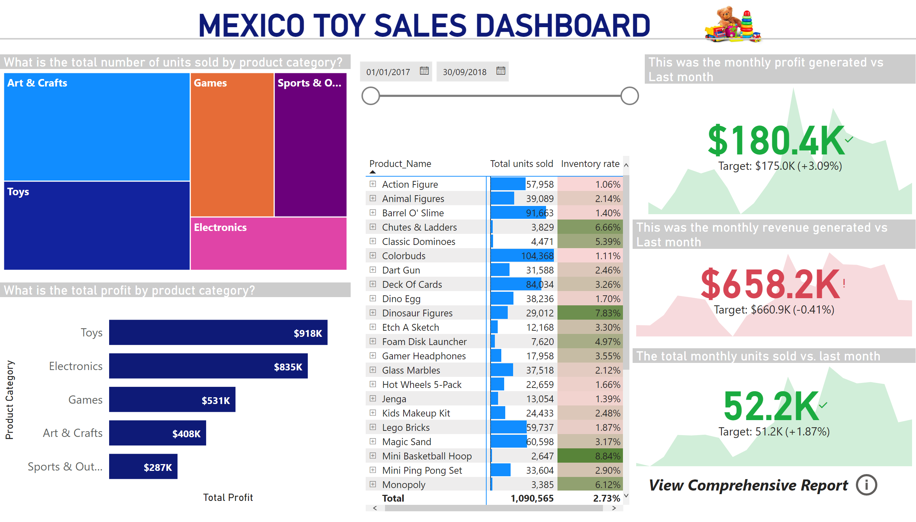
Executive Report
Notes:
MEXICO TOY SALES DASHBOARD
No alt text provided
image
No alt text provided
shape
No alt text provided
What is the total number of units sold by product category?
No alt text provided
What is the total profit by product category?
No alt text provided
pivotTable
No alt text provided
slicer
No alt text provided
This was the monthly profit generated vs Last month
No alt text provided
This was the monthly revenue generated vs Last month
No alt text provided
The total monthly units sold vs. last month
No alt text provided
textbox
No alt text provided
actionButton
No alt text provided

Slide 3
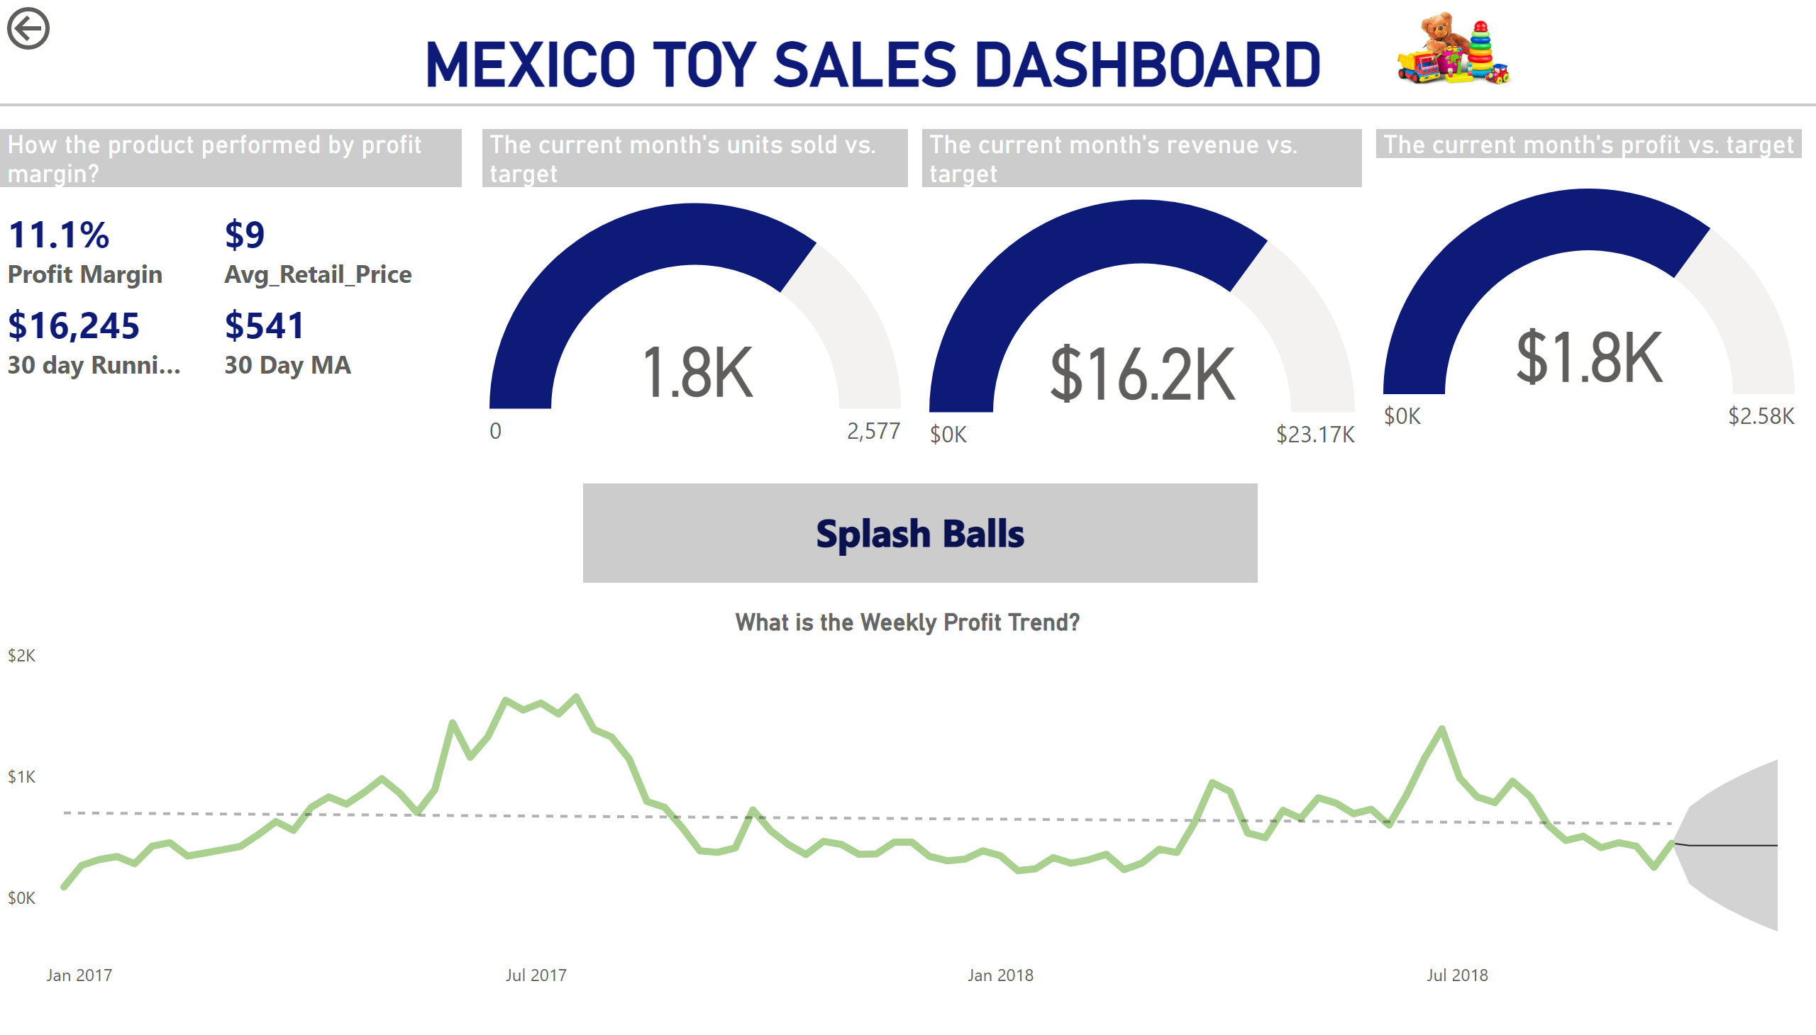
Product Details Report
Notes:
MEXICO TOY SALES DASHBOARD
No alt text provided
image
No alt text provided
shape
No alt text provided
slicer
No alt text provided
card
No alt text provided
What is the Weekly Profit Trend?
No alt text provided
The current month's units sold vs. target
No alt text provided
The current month's revenue vs. target
No alt text provided
The current month's profit vs. target
No alt text provided
actionButton
No alt text provided
How the product performed by profit margin?
No alt text provided

Slide 4
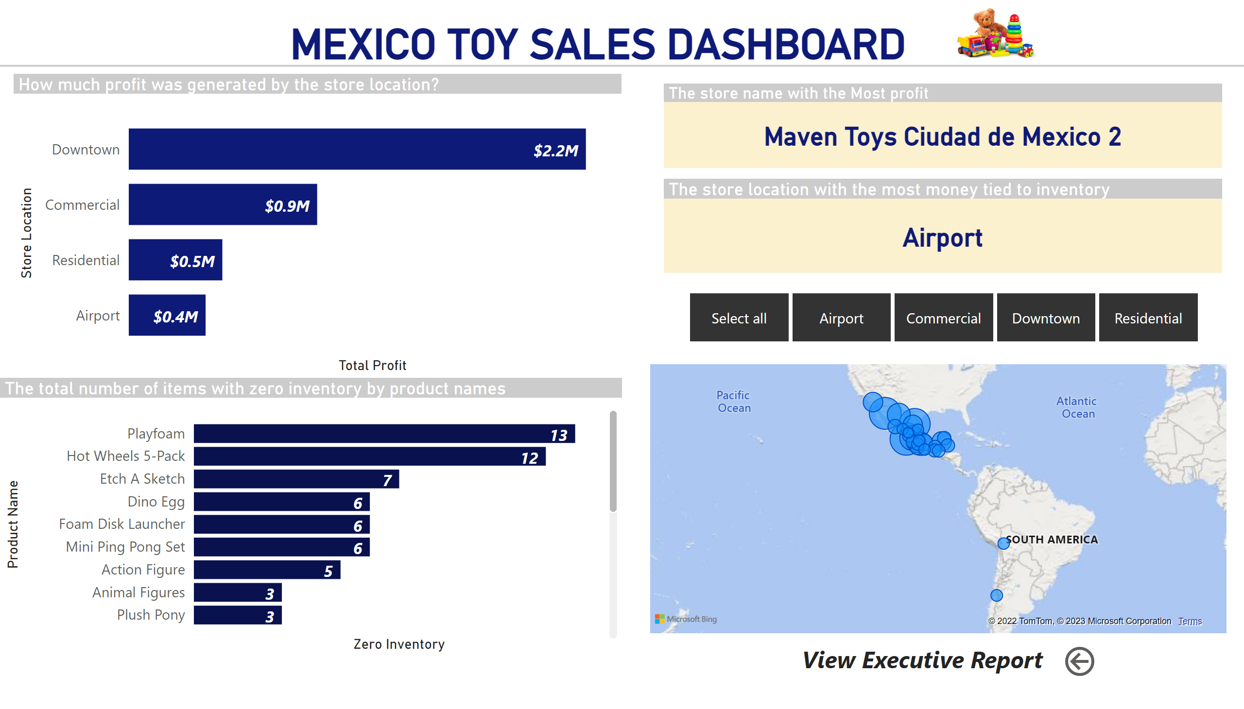
Comprehensive Report
Notes:
MEXICO TOY SALES DASHBOARD
No alt text provided
image
No alt text provided
shape
No alt text provided
slicer
No alt text provided
How much profit was generated by the store location?
No alt text provided
The total number of items with zero inventory by product names
No alt text provided
map
No alt text provided
The store name with the Most profit
No alt text provided
The store location with the most money tied to inventory
No alt text provided
slicer
No alt text provided
textbox
No alt text provided
actionButton
No alt text provided

